Slide 1
League of Legends 2019 game data analysis
-Huijie Fei

Slide 2
Agenda
Game Rule
Side analysis
Milestones analysis
Champions analysis and browser
LPL team analysis
LPL-player analysis
Final champion

Slide 3
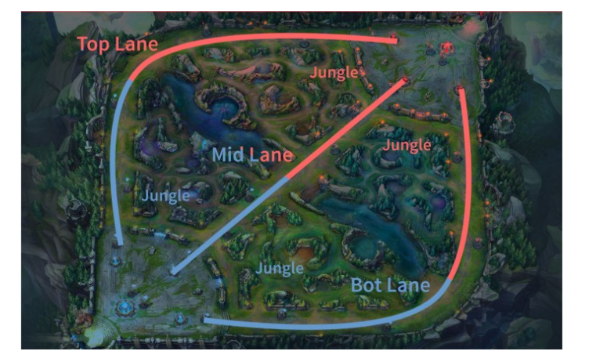
Rule

Slide 4
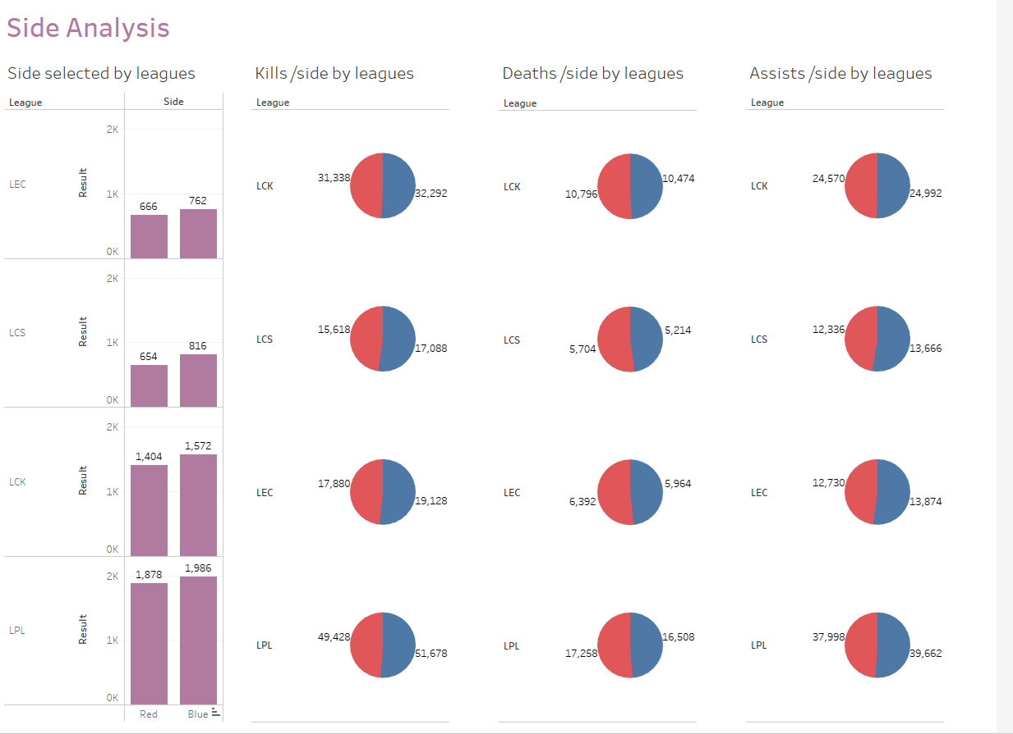

Slide 5
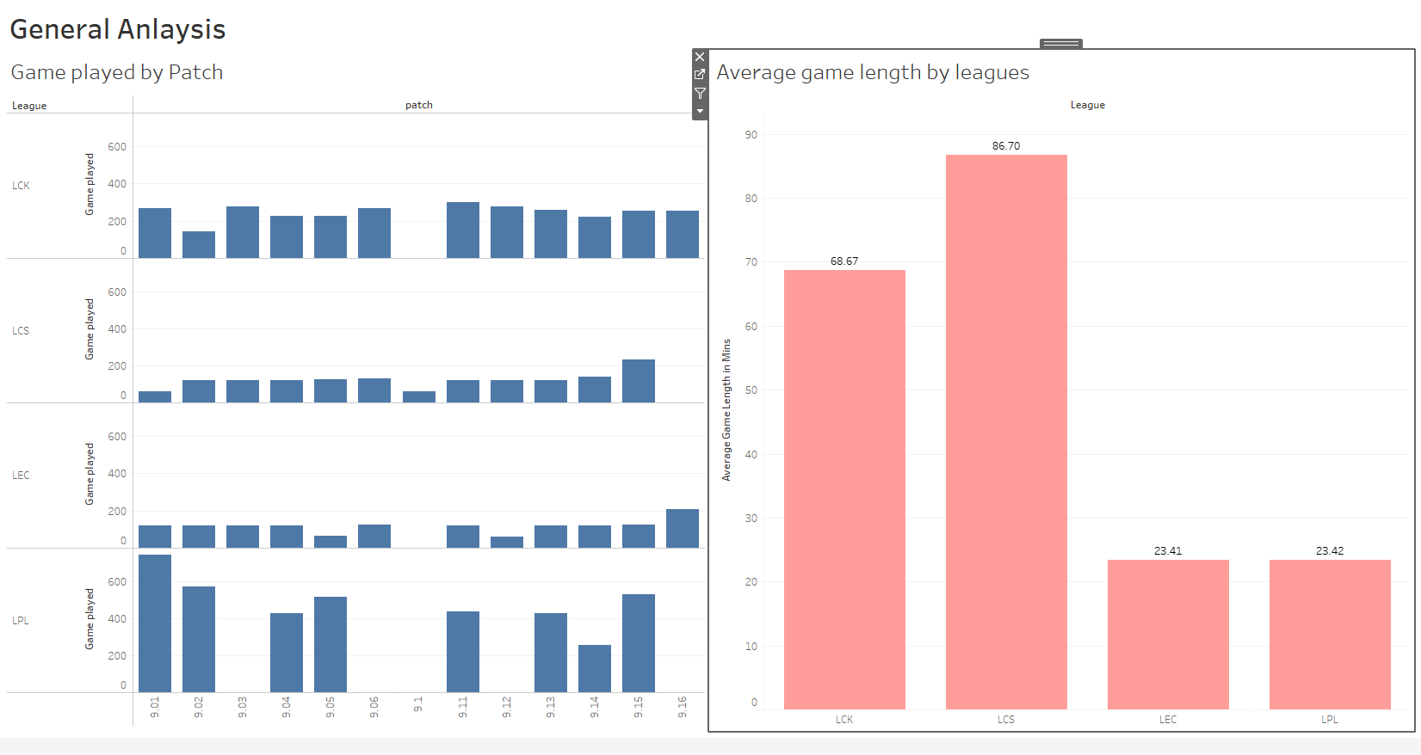

Slide 6
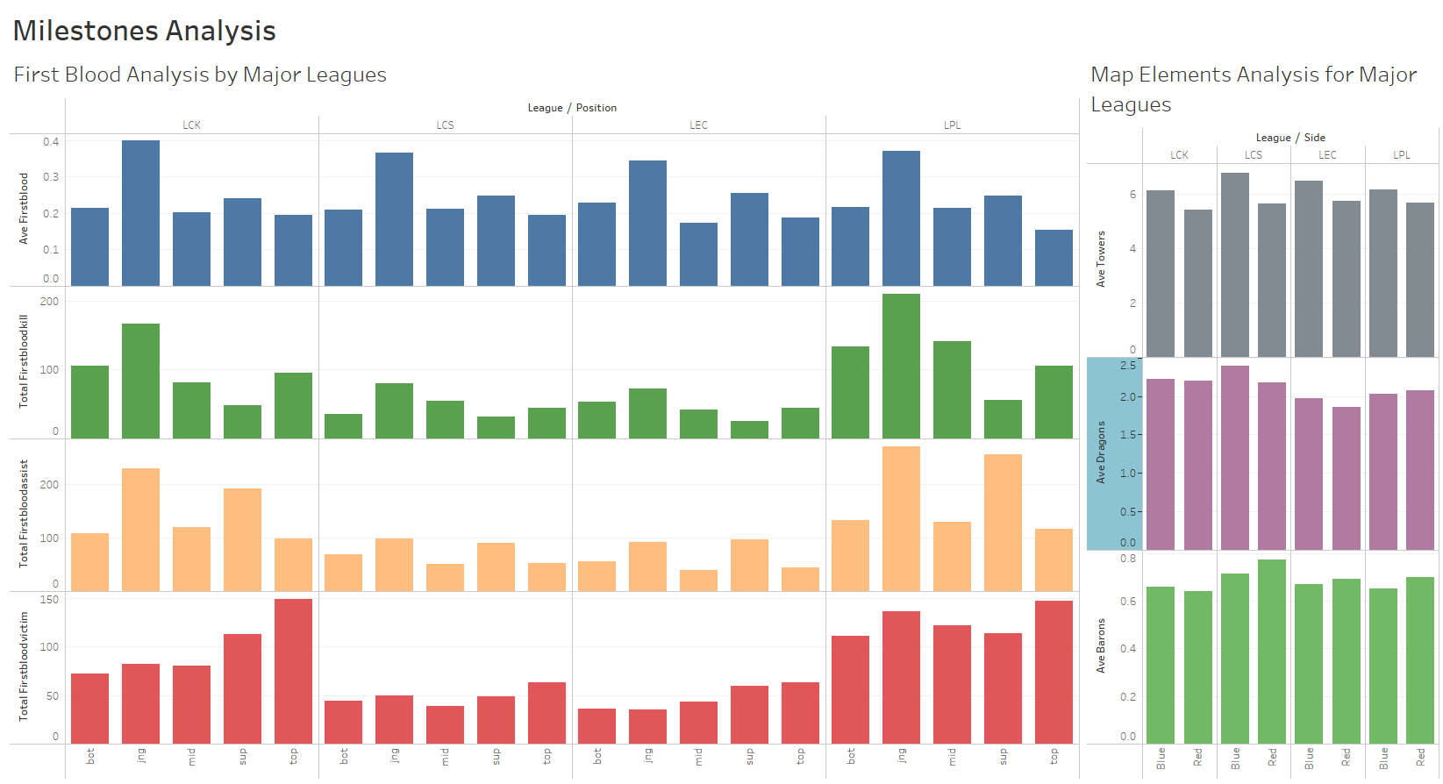

Slide 7
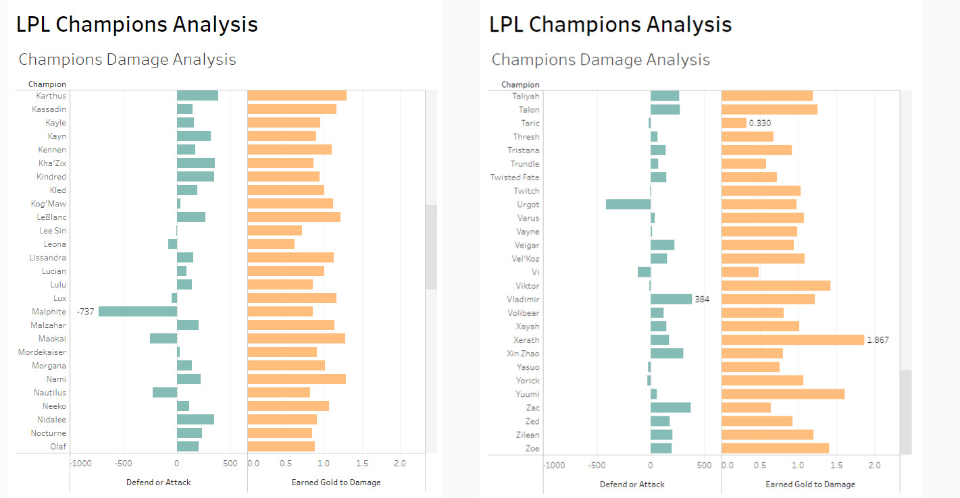

Slide 8
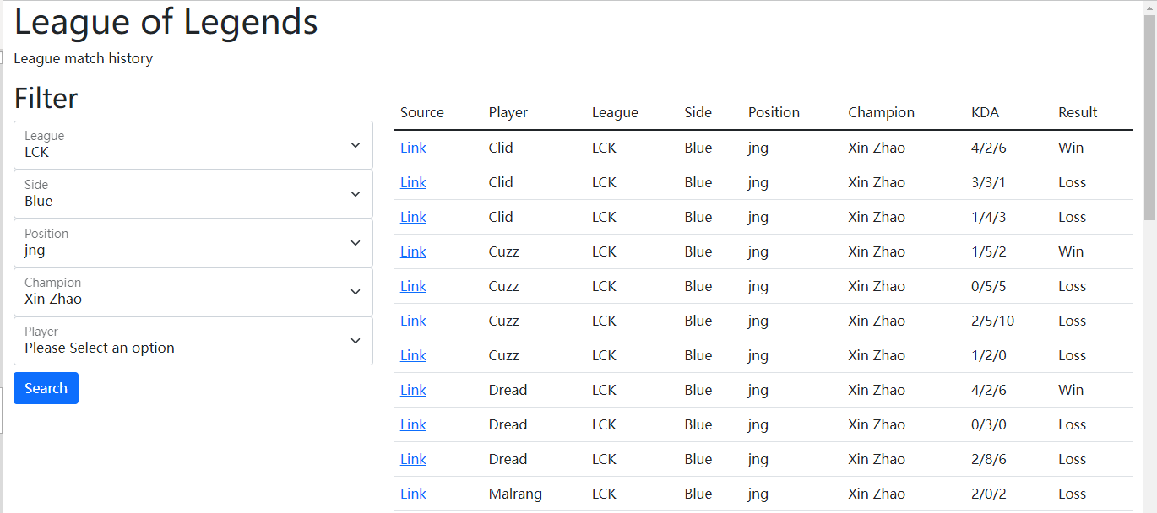

Slide 9
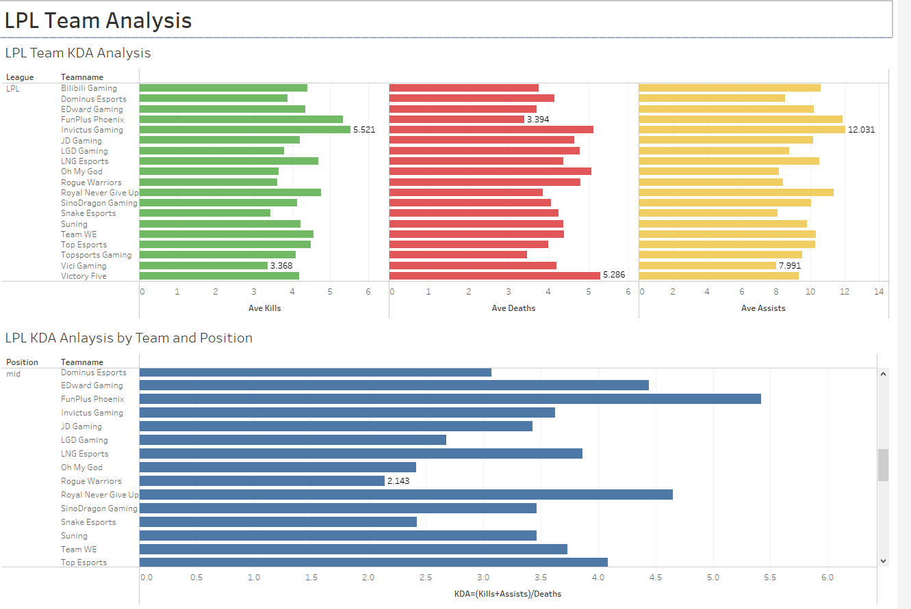

Slide 10
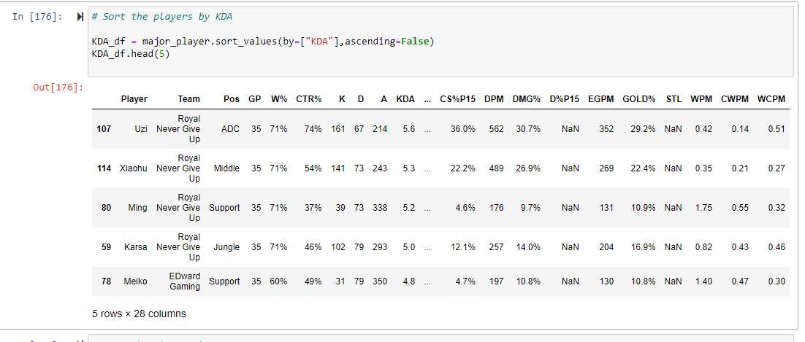
LPL-Player analysis(2019 summer season)

Slide 11
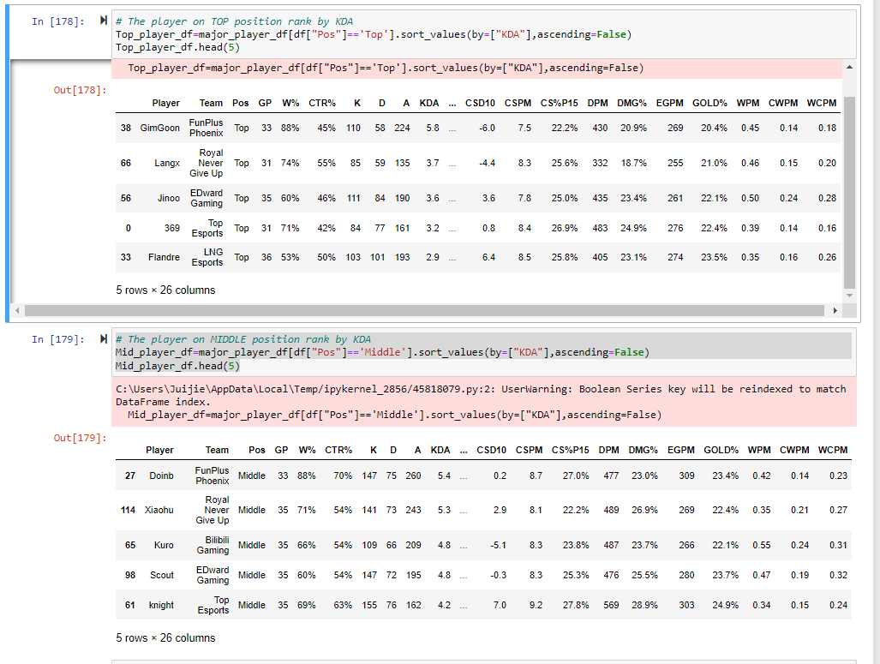

Slide 12
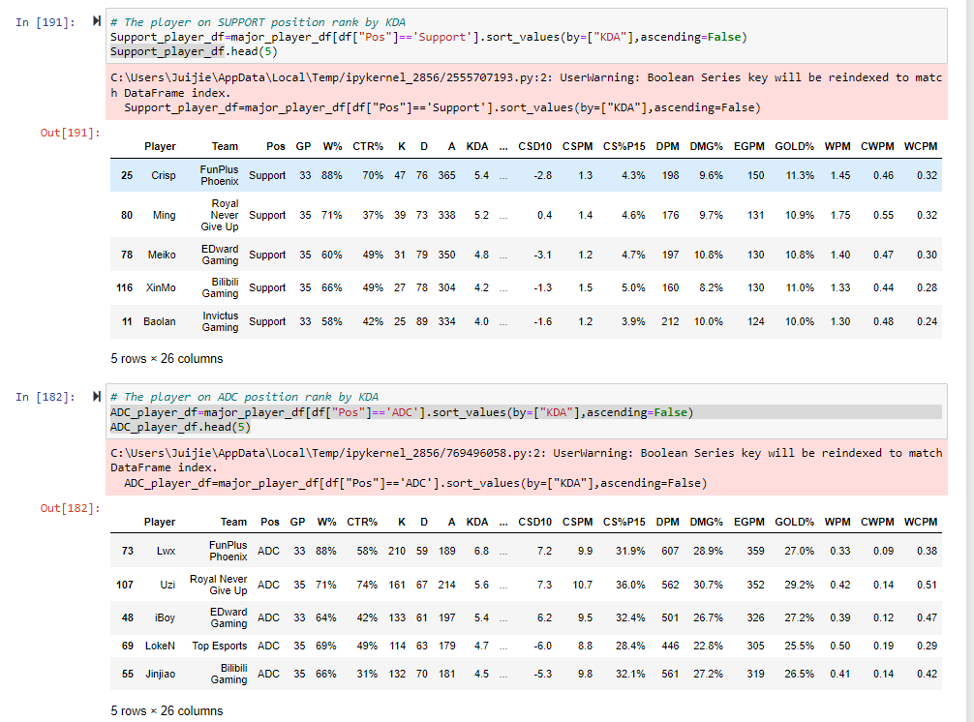

Slide 13
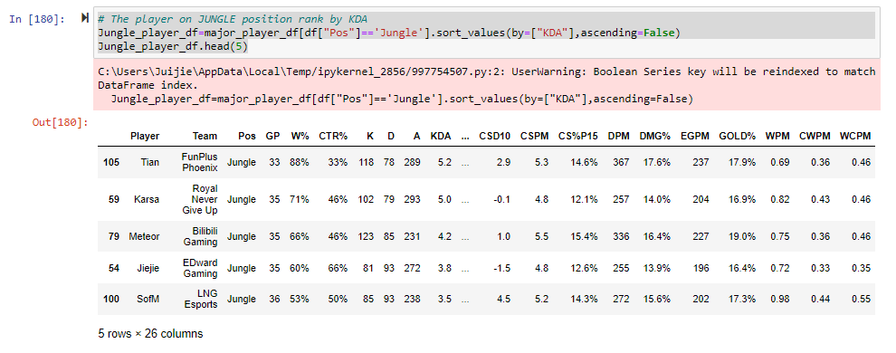

Slide 14
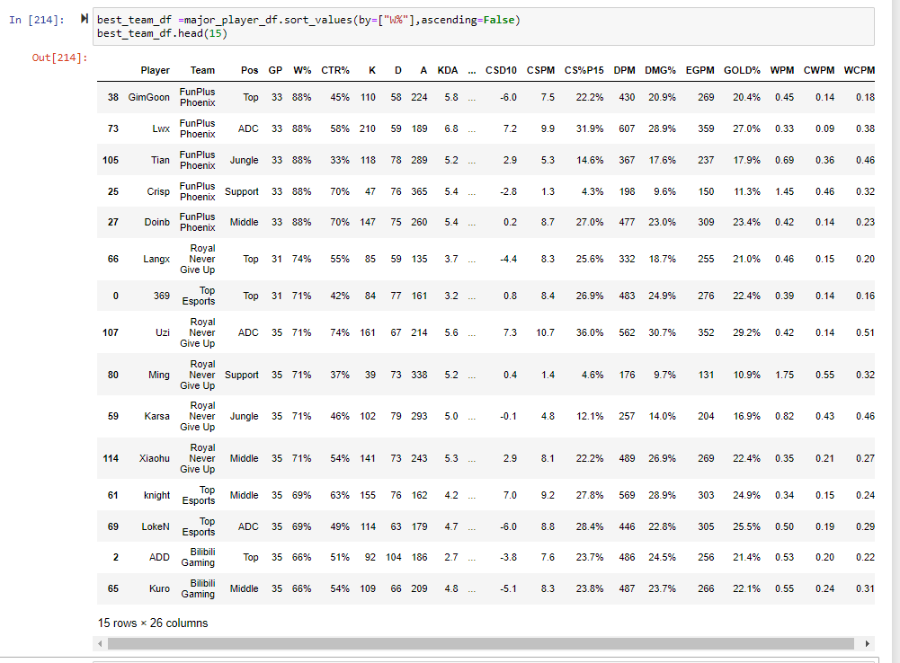

Slide 15
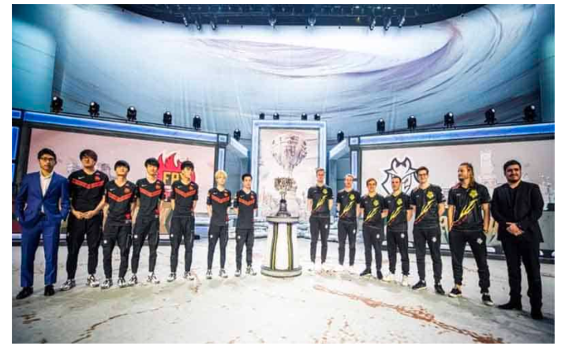
2019 Final Champion

